Slide 1


Team Building RLI - Part 2
Notes:
Begin the session:
Introduce self
Describe format for the session
Talk about what materials are available and/or where they can be found

Slide 2
Goals:
Discuss
Discuss advantages and disadvantages of committees
Explore
Explore how committees and team building are used in Rotary clubs
Recognize
Recognize the importance of team building in the life of a Rotary club
Reflect
Reflect on how committees can be used as a tool of leadership
Notes:
Review Session Goals, where this course fits into the Leadership curriculum of RLI
Quickly review Insert: TB-1 “Good to Know for Team Building”

Slide 3
1
2
“Alone we can do so little; together we can do so much” Helen Keller
“If I have seen further, it is by standing on the shoulder of giants” Isaac Newton
Notes:
Invite the group to view the two quotes on the screen.
There are two quotes on the screen. Choose which one speaks to you and tell us WHY. Raise your VIRTUAL HAND and unmute to offer your thoughts
Ask for one or two volunteers to share some thoughts about why they chose the one they chose.

Slide 4

Let’s Have a Debate!
Resolved:
The most effective committee is a committee of ONE.
Notes:
Introduce the debate exercise.
In Rotary clubs, it can be challenging to put a successful committee structure in place. To open this discussion, we are going to debate the following proposition.
RESOLVED: THE MOST EFFECTIVE COMMITTEE IS A COMMITTEE OF ONE
Divide participants into two (2) BREAKOUT room groups. (Groups can be as small as one (1) or as large as six (6).
Assign one group to be the Affirmative Team (argues FOR the resolution) and the other to be the Negative Team (argues AGAINST the resolution.
In the breakout rooms you will have 8 minutes to formulate your strategy for the debate. Choose two (2) members of your team to present your case (AFF 1 and AFF 2; NEG 1 and NEG 2).
This may seem like an obviously false statement, however how many times in Rotary clubs does one person end up doing things by themselves? Most of us have experienced this, many times in many situations
Allow 8 minutes for each team to determine their strategies.
Two members from each team will present their team’s case
Initiate Breakouts
Bring back after 8 minutes

Slide 5
Prepare for your Debate (Instructions)
In Rotary clubs, it can be challenging to put a successful committee structure in place. To open this discussion, we are going to debate the following proposition.
RESOLVED: THE MOST EFFECTIVE COMMITTEE IS A COMMITTEE OF ONE
Assign one group to be the Affirmative Team (argues FOR the resolution) and the other to be the Negative Team (argues AGAINST the resolution.
In the breakout rooms you will have 8 minutes to formulate your strategy for the debate. Choose two (2) members of your team to present your case (AFF 1 and AFF 2; NEG 1 and NEG 2).
Each team will have 8 minutes to determine their strategies.
Two members from each team will present their team’s case.
Notes:
In order to share this slide to breakout rooms, you don’t need to stop sharing. Just hit the Share button again, and maker sure you click the option to “Share to Breakouts” along the right side of the screen. This option is not available until AFTER breakouts are started.
You may also “Broadcast” your voice to breakouts if you wish to give them more specific instructions, such as letting them know who is in each breakout. If you draw or mark anything on YOUR screen using Annotation Tools, they will also see that in the breakouts.
Note: If the person sharing (normally the Facilitator) joins a breakout, screen sharing will stop. For this reason, it may make sense to use a second computer to visit participants in breakouts, or to have the Producer share this slide to breakouts.

Slide 6
Modified Debate Format
TIMING | TEAM | TASK
2 minutes | Affirmative 1 | State your case
2 minutes | Negative 1 | Tear down the case
2 minutes | Affirmative 2 | Rebut, rebuild case, add advantages
2 minutes | Negative 2 | Continue to tear down case
2 minute | TIMEOUT | Return to breakouts to plan closing strategy
1 minute | Negative 1 | Summarize
1 minute | Affirmative 1 | Summarize
1 minute | Negative 2 | Conclude
1 minute | Affirmative 2 | Conclude
Notes:
Follow the order and time as indicated on the chart on the screen
Facilitator will act as a judge
Let the debate begin!
NOTE: If there are only two participants, assign one as affirmative and the other as negative, adjust timing accordingly
Conduct the debate according to the schedule provided
Give each side allotted time to present their case
Timeout – return to breakouts to plan for closing strategy
Give Closing arguments

Slide 7
Poll – Who Won the Debate?
Affirmative Team
Negative Team
Notes:
Conduct a poll to determine who the group believes won the debate (NOT which view one agrees with)
Emphasize that their vote should reflect which team made the best argument not who argued on the side you agree with.
Launch the POLL
End the POLL and share results

Slide 8

Group Teambuilding
“How to carry the leadership load?”
Notes:
Debrief the debate activity by leading a discussion which points out the following:
The first step in working with a team is to recognize that though easier to work alone it is ultimately better for completing the task, for the individual and for the whole to include others.
Leaders that choose to “do it all” often burnout
As judge of the debate, point out that everybody wins if they take their observations from the debate back to the club.

Slide 9

Situation
New club
Four enthusiastic officers
Service projects attracted a lot of new members
Load became too much for the four original officers
Committee formed to find a solution
Notes:
This exercise looks at a situation in which officers in a new club were overwhelmed as the Rotary club grew
Let’s explore another aspect of teambuilding. Turn to page 39, INSERT TB-2 Urbana University of Illinois Exercise. Follow along while I read the narrative.
Read the exercise to the group.
Divide the group into two (2) or three (3) groups.

Slide 10

How can this club build a team?
Notes:
Introduce their task in the second BREAKOUT group:
Given the situation facing this club develop a recommendation on how this club can build a team. What specific steps do they need to follow. We’ll breakout into groups now.
Initiate BREAKOUTS
End BREAKOUTS in 8 minutes.
Invite groups to share their recommendations.

Slide 11
BREAKOUT INSTRUCTIONS
Given the situation facing this club develop a recommendation on how this club can build a team.
What specific steps do they need to follow. We’ll breakout into groups now.
Background: The club began six months ago with four leaders who had become impressed with Rotary through Polio Plus activity and results. They started meeting weekly on Wednesdays at 5:30 and agreed amongst themselves that they would bring together a strong group of leaders like themselves within the next year. The four took on the ofﬁces of President, Vice President, Secretary, and Treasurer. To date they have recruited 26 new members.
Within a month, a community service project was accomplished each month. These projects were being so well accomplished by the team of four that new members were recruited by each new project. Each club meeting was a planning meeting for next month‛s project or a speaker from the community describing a speciﬁc need. New members were put in charge of certain parts of the service projects. As members became excited about what the club was able to accomplish, they started to recommend their friends for membership.
New members were also recruited from the club program speakers.
Current Situation:
In two weeks, they will install and welcome ten more members. But the group of four are getting overwhelmed with everything. So, President Jack told the other ofﬁcers, “we need to build an effective team to help carry the leadership load. I am appointing a committee to produce a recommendation on how we can build a team.”
Notes:
In order to share this slide to breakout rooms, you don’t need to stop sharing. Just hit the Share button again, and maker sure you click the option to “Share to Breakouts” along the right side of the screen. This option is not available until AFTER breakouts are started.
You may also “Broadcast” your voice to breakouts if you wish to give them more specific instructions, such as letting them know who is in each breakout. If you draw or mark anything on YOUR screen using Annotation Tools, they will also see that in the breakouts.
Note: If the person sharing (normally the Facilitator) joins a breakout, screen sharing will stop. For this reason, it may make sense to use a second computer to visit participants in breakouts, or to have the Producer share this slide to breakouts.

Slide 12
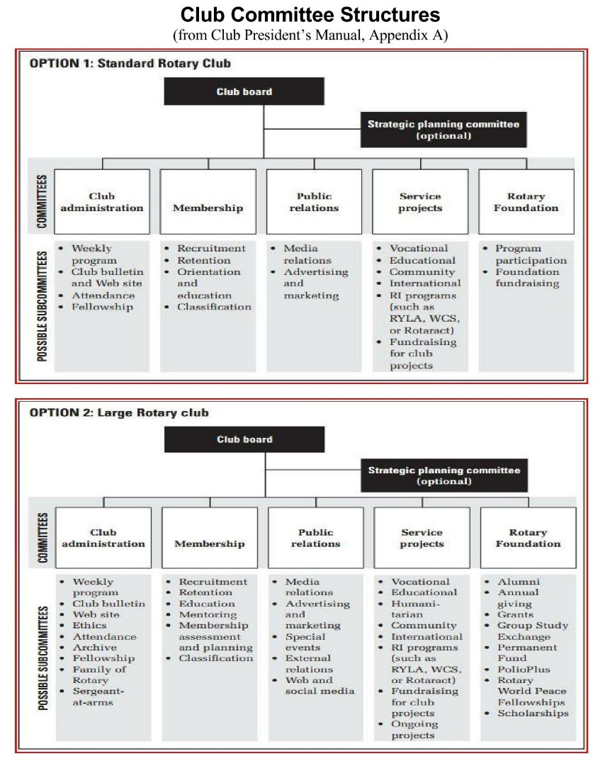
Club Organization – Committee Structure
Each club is different
Use Rotary resources as a guide
Notes:
Debrief the BREAKOUT activity referring back to team building concepts
Rotary Clubs and committees within clubs are teams, just like in business, sports and other endeavors
The organization of a club, i.e. committee structure, is completely up to the club to determine. Rotary International suggests several alternative committee structures for clubs to consider. Clubs should pick or design a committee structure that matches their club’s members and club dynamic.
Refer to the Sample Club Committee Structure (Participant Manual – page 41)

Slide 13

What’s Next?
Reflecting on all we have talked about today – What would you do to make effective use of teams and committees in your club?
Notes:
Challenge the participants to use some of that they heard in this session to build effective teams in their own clubs.
After our discussions today about team building and effective use of people, how can we make effective use of Rotarian teams and committees?
How important is delegation of tasks and duties?
How would you proceed to do that?

